Slide 1
RECIST 1.1 Overview

Slide 2
Agenda
Background to Cancer Treatment and Medical Imaging
What is RECIST?
Classifying Lesions at Baseline
Schedule of Assessments
Methods of Assessment
Evaluation of Tumor Response
Site Management
RECIST 1.1 Data Collection
Visit Schedule Compliance
Summary

Slide 3
Background to Cancer Treatment & Medical Imaging

Slide 4
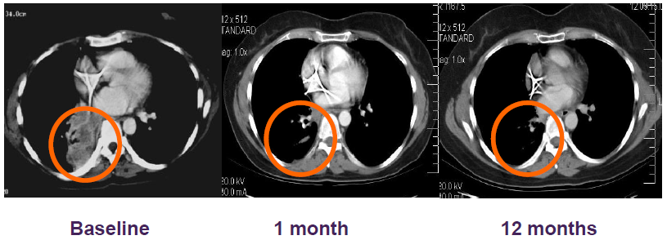
Cancer Treatment & Medical Imaging
IRESSATM Lung cancer
Primary lung tumor assessment

Slide 5
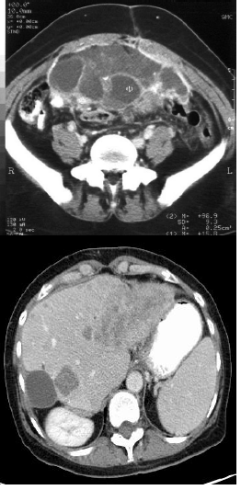
What is RECIST?
Response Evaluation Criteria In Solid Tumors
It is a set of published rules* that define when cancers:
Respond(improve)
are Stable(stay the same)
Progress(worsen)
RECIST standardises solid tumor response evaluation to ensure uniform collection and reporting of clinical study outcomes
*Therasse et al; New Guidelines to Evaluate the Response to Treatment in Solid Tumours, J Natl Cancer Inst 2000; 92 (3): 205-216

Slide 6
What is RECIST 1.1.
Issues with RECIST 1.0 resolved
Main changes
Number of target lesions
Definition of measurable lesions
Assessment of pathological lymph nodes
Clarification of progression requirements
Revision of methods of assessment
Eisenhauer et al; New response evaluation criteria in solid tumors: Revised RECIST guideline (version 1.1), Eur J Cancer 2009; 45: 228-247

Slide 7
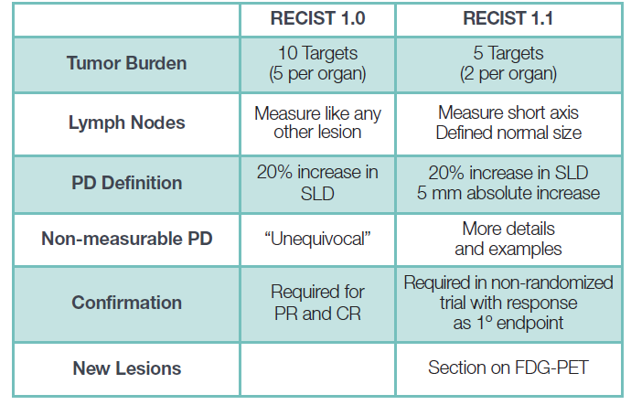
What Has Changed: RECIST 1.0 – RECIST 1.1

Slide 8
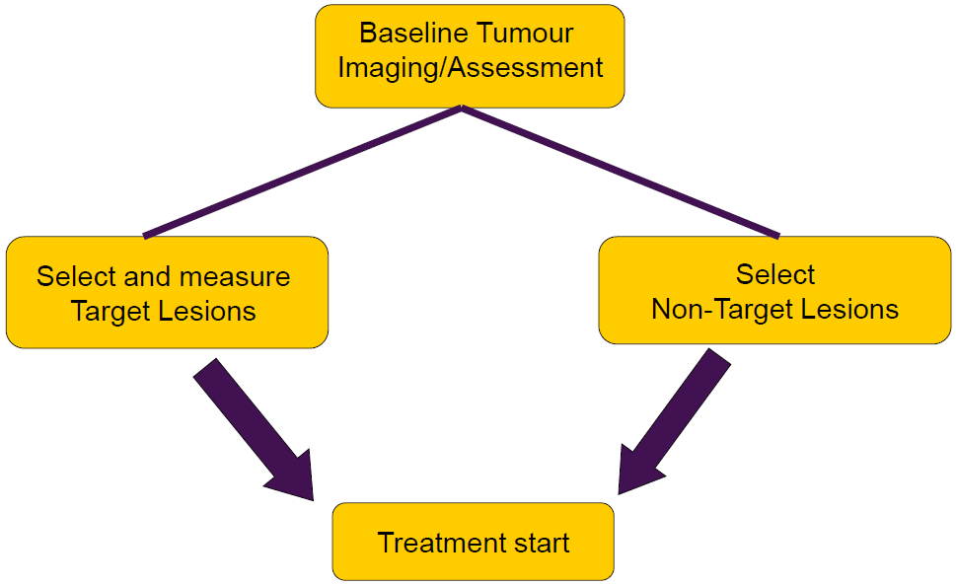
Baseline Assessment

Slide 9
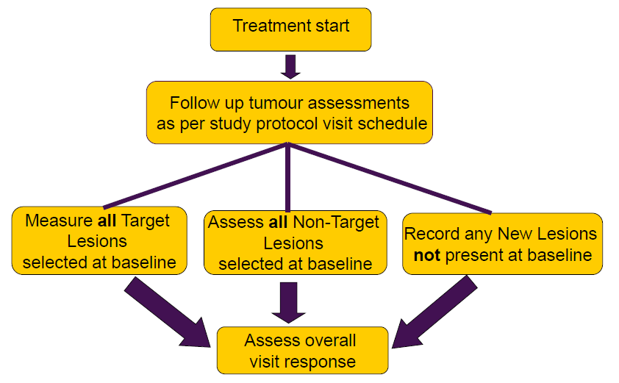
Follow Up Assessment

Slide 10
Classifying Lesions at Baseline

Slide 11
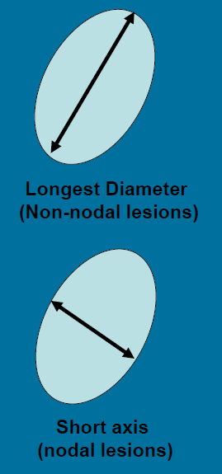
Target Lesions
Can be accurately measured in at least one
dimension
Selection is based on size and suitability
For accurate repeated measurements
Longest diameter for non-nodal lesions
Short axis for lymph nodes(nodal lesions)
Not previously irradiated
Measurements at baseline must be:
≥ 10mm in longest diameter for non-nodal lesions with Computed Tomography (CT) scan or Magnetic Resonance Imaging (MRI)
≥ 15mm in short axis for nodal lesions by CT or MRI

Slide 12
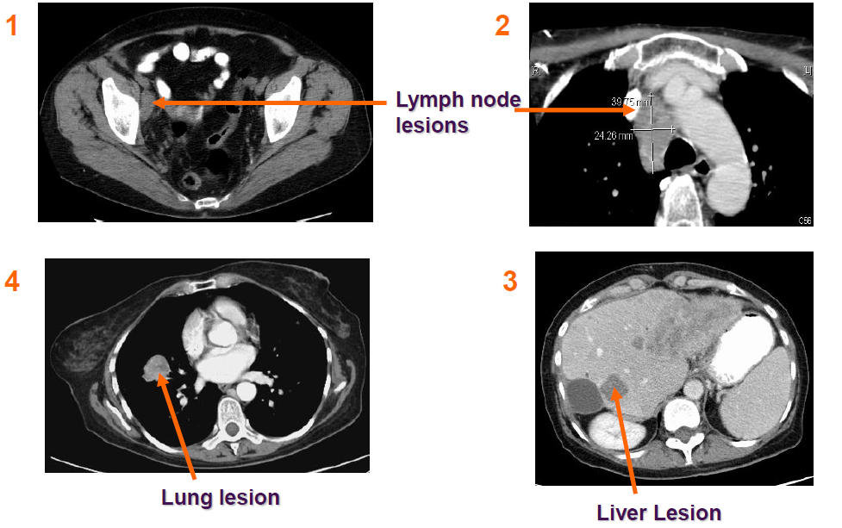
Examples of Target Lesions

Slide 13
Target Lesions
Baseline Selection
Maximum of 5
Representative of all involved organs
No more than 2 per organ
Measurements made at all time points
Longest diameter for non-nodal lesions
Short axis for lymph nodes (nodal lesions)
Sum of diameters for all Target Lesions is used to calculate response

Slide 14
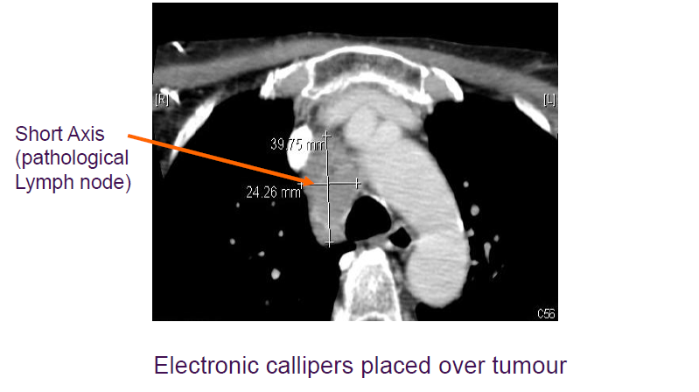
Measurements on CT Scan

Slide 15
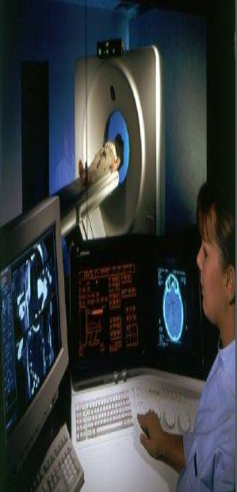
Non-Target Lesions
Selected at baseline
All other lesions including:
Small non-measurable lesions
Non-nodal lesions with longest diameter < 10mm with CT/MRI
Pathological lymph nodes with short axis ≥ 10 mm and < 15 mm
Truly non-measurable lesions
Bone lesions
Ascites
Pleural/pericardial effusion
Previously irradiated lesions
Skin lesions assessed by clinical examination
Brain metastases
Excess Target Lesions

Slide 16
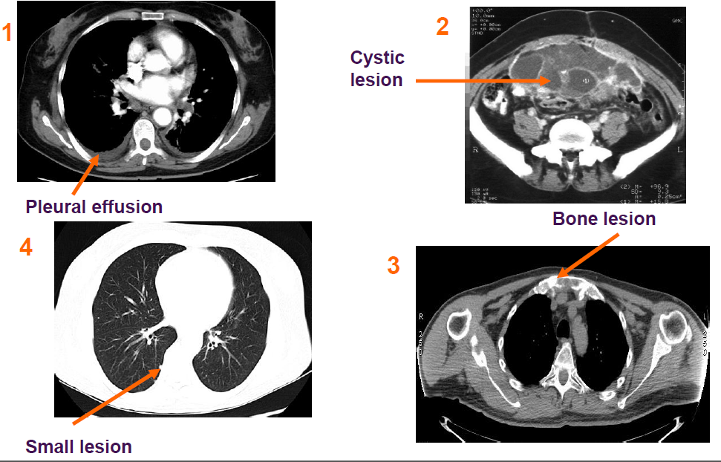
Examples of Non-Target Lesions

Slide 17
Schedule of Assessments

Slide 18
Schedule of Assessments
Baseline tumour assessment
As close as possible to treatment start
Always within 28 days before start of treatment
Follow-up tumour assessments
Assessments of all Target and Non-Target Lesions performed every X weeks (+/-Y weeks) according to the protocol visit schedule
In many studies patients followed until disease progression even if study treatment is discontinued and/or the patient receives a subsequent cancer therapy

Slide 19
Methods of Assessment

Slide 20
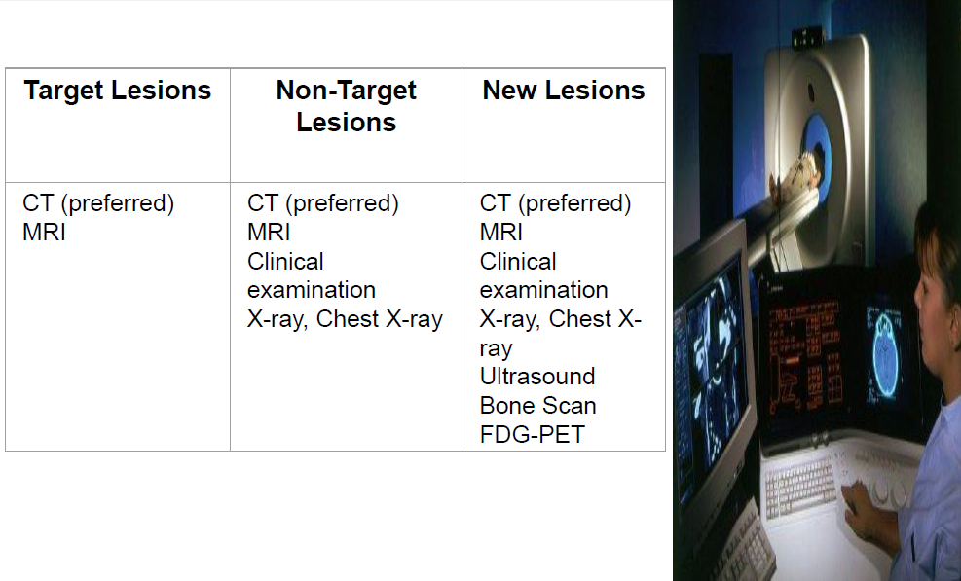
Acceptable Methods of Assessment

Slide 21
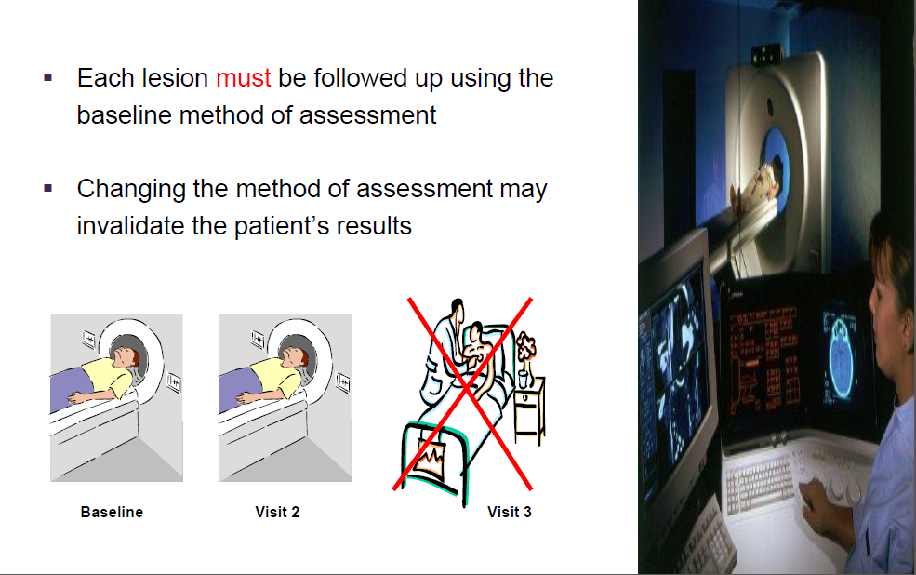
Acceptable Methods of Assessment

Slide 22
Evaluation of Tumour Response

Slide 23
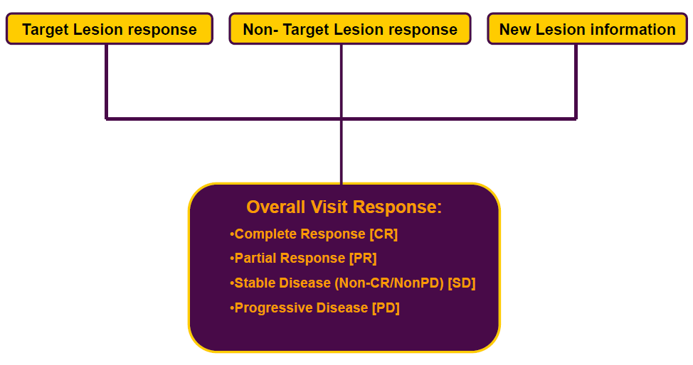
Overall Visit Response

Slide 24
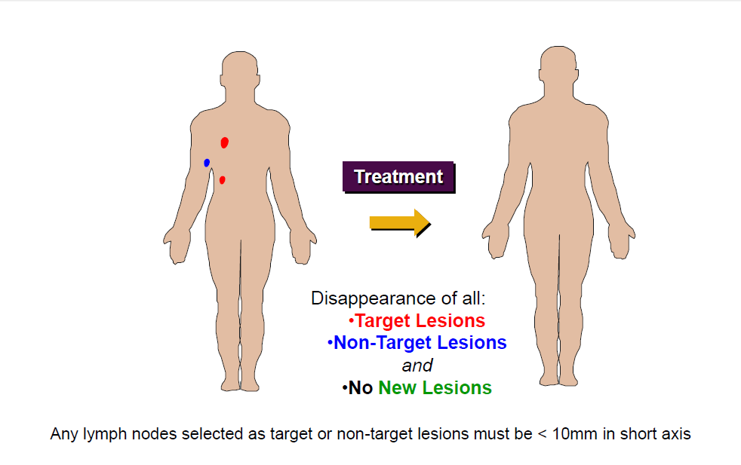
Complete Response

Slide 25
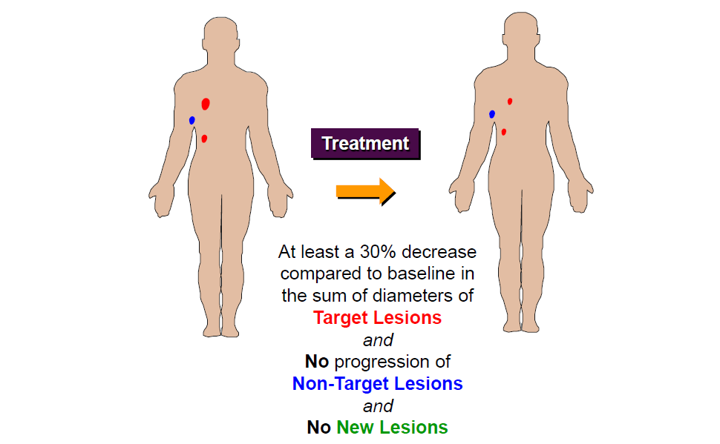
Partial Response

Slide 26
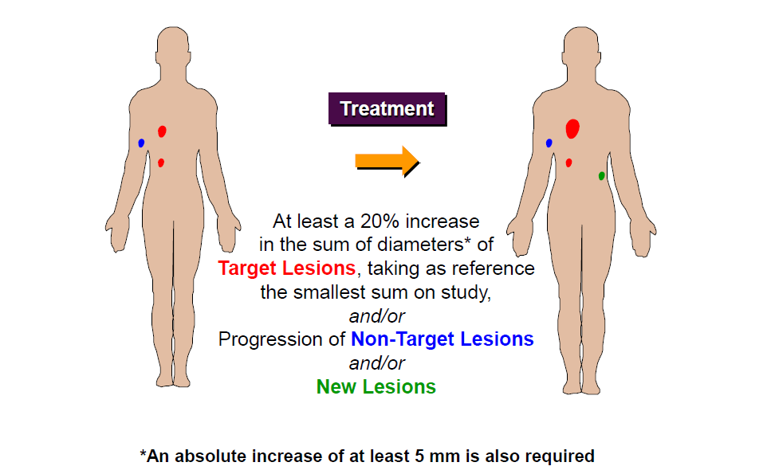
Progressive Disease

Slide 27
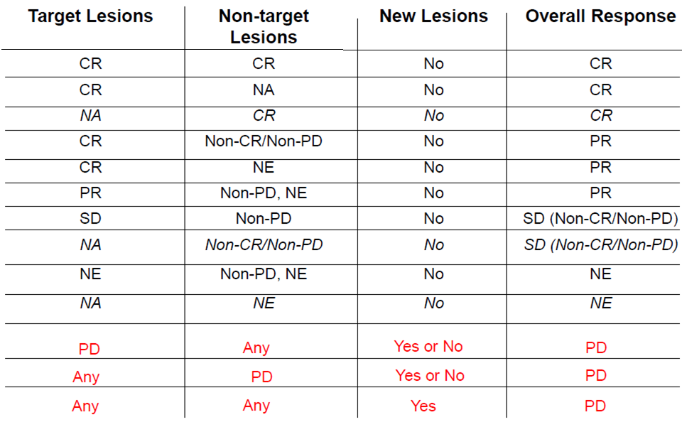
Summary of Overall Visit Response

Slide 28
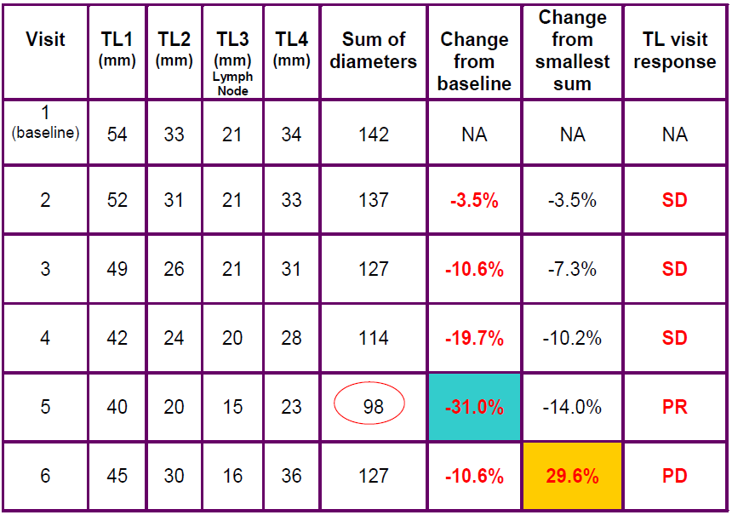
Target Lesion Visit Response

Slide 29
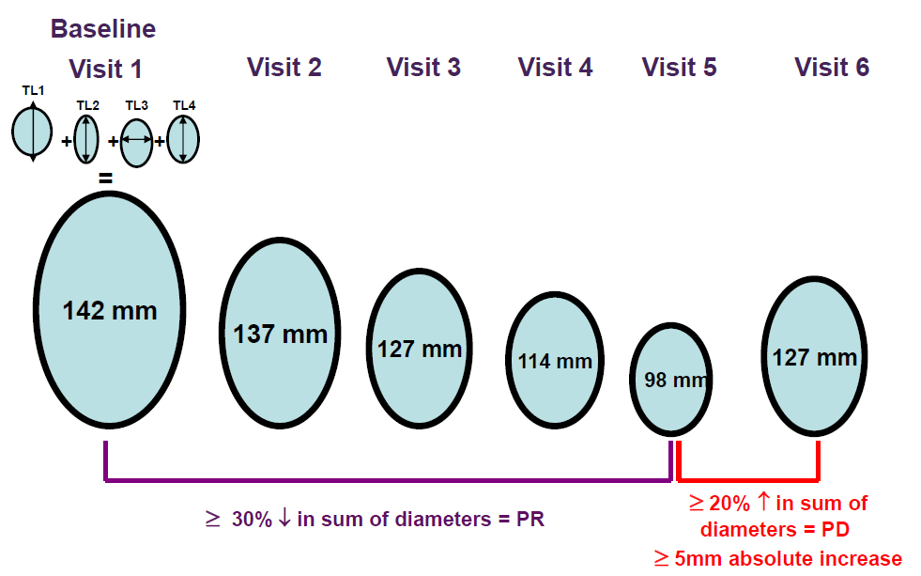
Target Lesion Visit Response

Slide 30
Site Management

Slide 31
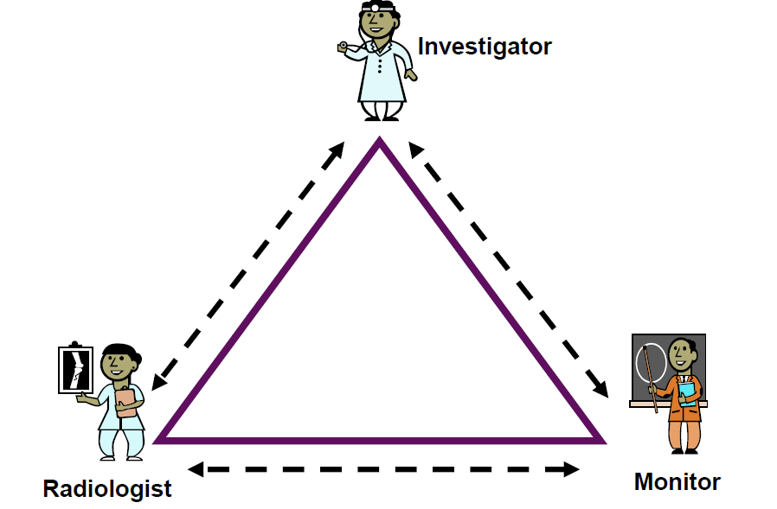
Local Site Management

Slide 32
Key Considerations
Ensure process in place for requesting RECIST assessments as per study protocol
Confirm who will perform the RECIST assessment
the same individual should read all scans for each patient
Ensure source data recorded either:
in the patient notes
in a radiology report
on a RECIST 1.1 data sheet signed and dated by the reviewer

Slide 33
Minimum Source Data Requirements 1
Target and Non-Target Lesions at baseline and follow-up
Anatomical site and location
Date of assessment and method used
Any lesion interventions (e.g. irradiation, surgery)
Longest diameter measurements (short axis for lymph nodes) [Target Lesions only]
Reasons for any missing or non-evaluable assessments
Reasons for any inconsistencies between radiology report and patient notes

Slide 34

Minimum Source Data Requirements 2
Details of any New Lesions
Site and location
Date of assessment and method used
Non-Target Lesion visit response assessed by Investigator
Overall RECIST visit response
Investigator’s opinion of visit response

Slide 35
RECIST 1.1 Data Collection

Slide 36
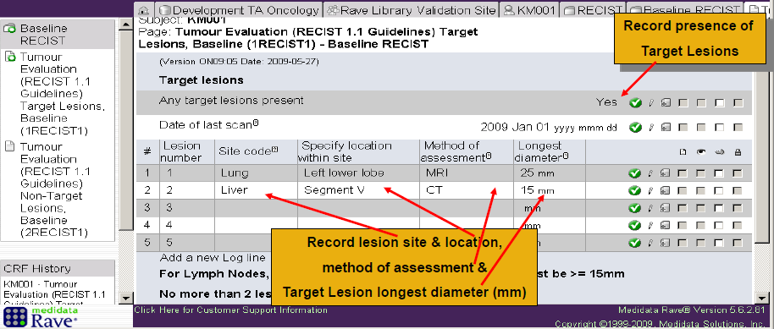
Baseline Data Collection (1)

Slide 37
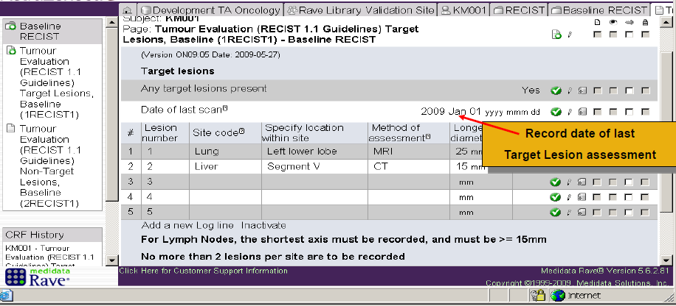
Baseline Data Collection (1)

Slide 38
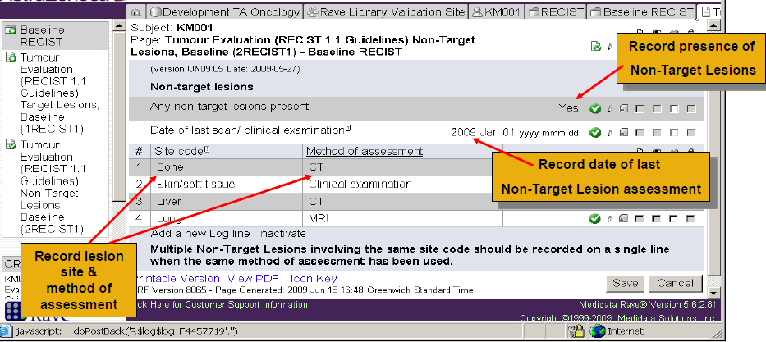
Baseline Data Collection (2)

Slide 39
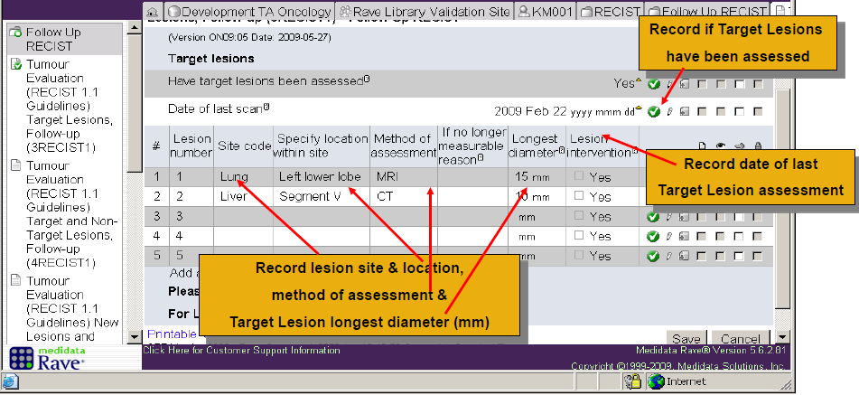
Follow-up Data Collection (1)

Slide 40
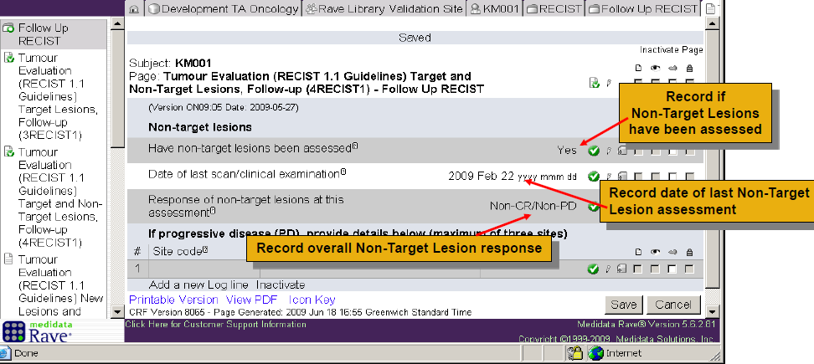
Follow-up Data Collection (2)

Slide 41
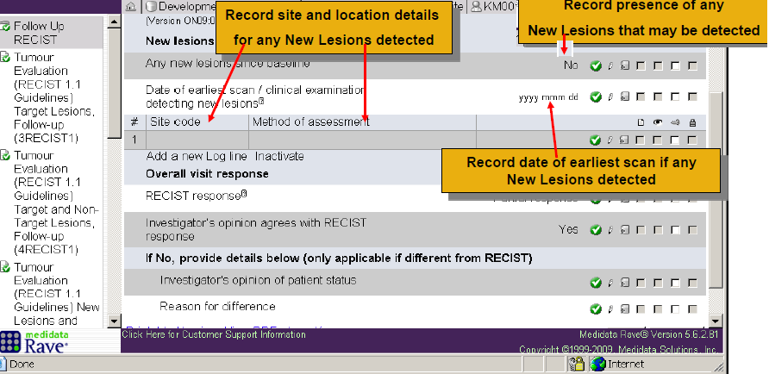
Follow-up Data Collection (3)

Slide 42
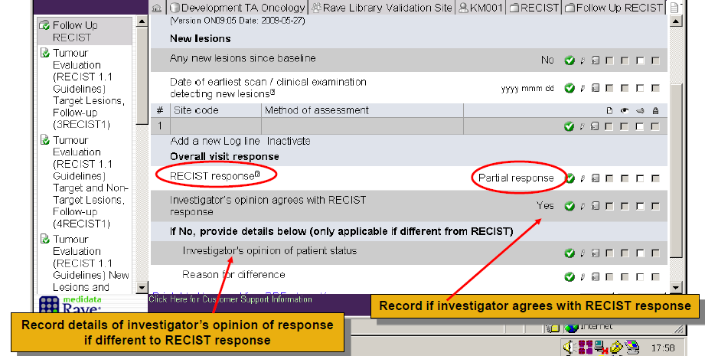
Follow-up Data Collection (3)

Slide 43
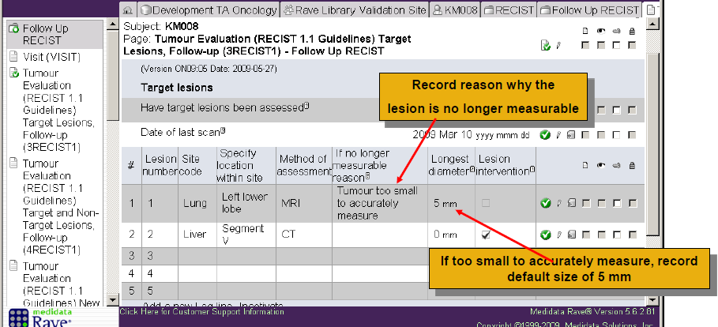
Target Lesion Measurement Issues & Interventions

Slide 44

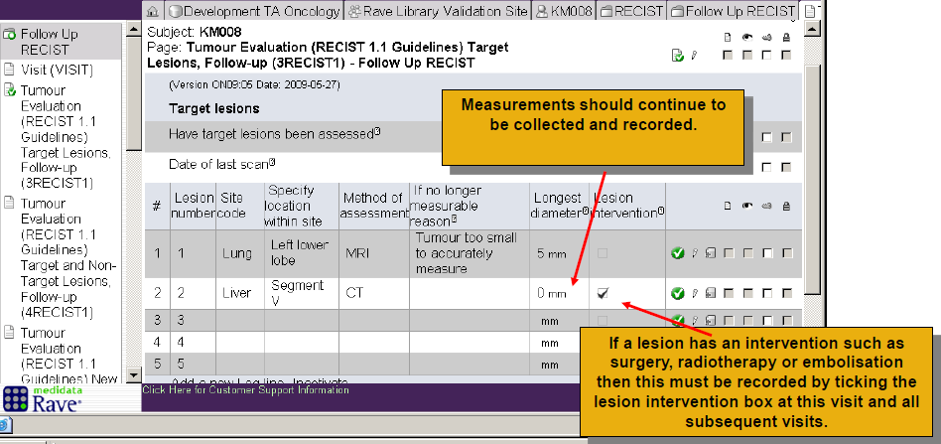

Slide 45
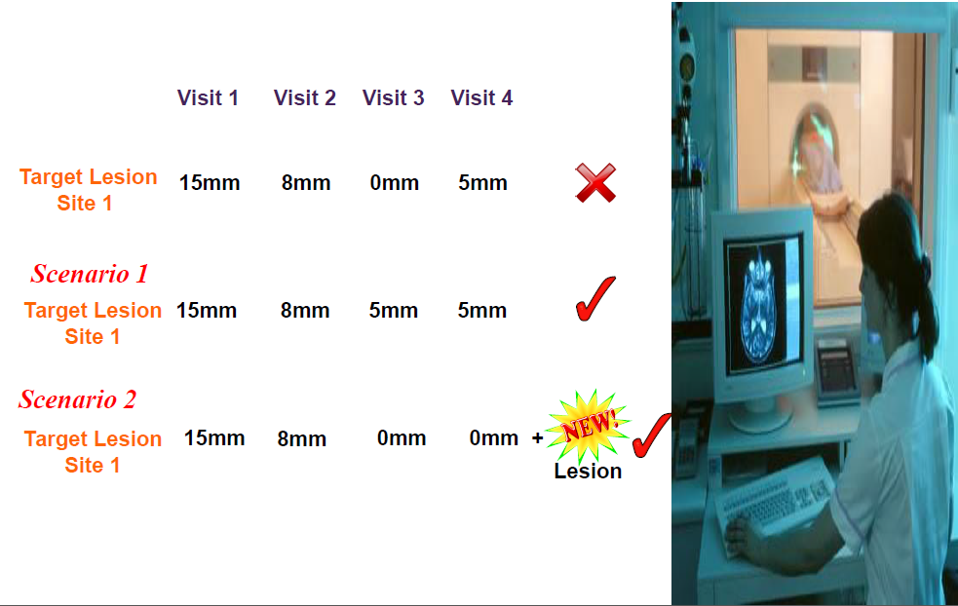
Target Lesions that Disappear

Slide 46
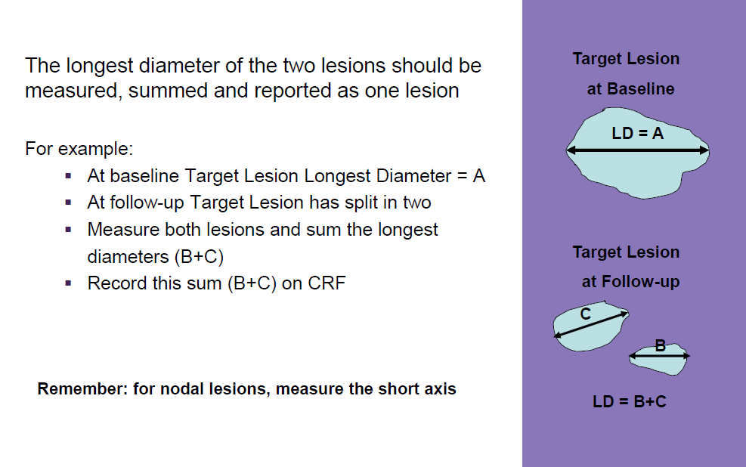
Target Lesions that Split in Two

Slide 47
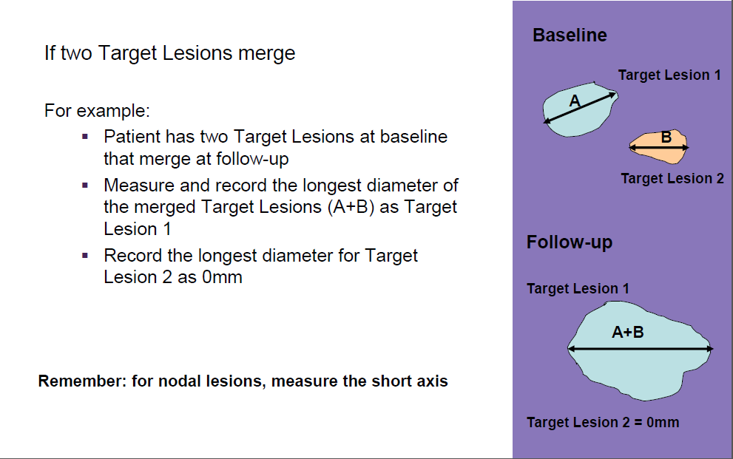
Target Lesions that Merge

Slide 48
Visit Schedule Compliance

Slide 49
Adherence to Visit Schedule
Bias may be introduced in randomised studies if one arm is assessed more frequently than another*
E.g. Date of progression is only known within an interval i.e. a patient had not progressed at week 18 but had progressed by week 24
Progression likely to be detected earlier in arm with more frequent assessments
Tumour assessments must be performed in accordance with visit schedule to avoid bias
*Williams G,He K, Chen G, ChiG, and Pazdur R. Operational bias in assessing time to progression (TTP).
Proc Am Assoc Cancer Res 2002; abst 975

Slide 50
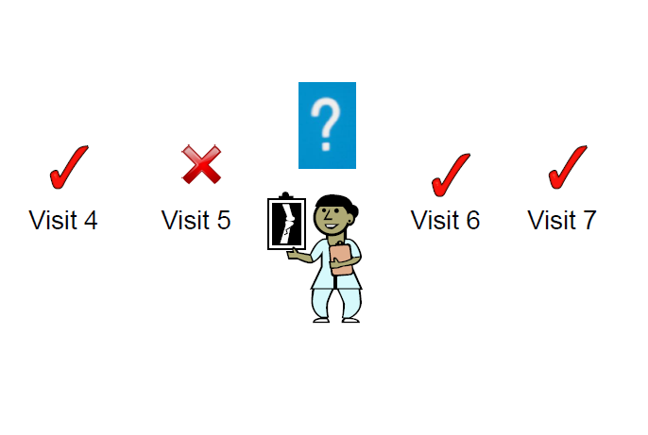
Handling Missed Visits

Slide 51
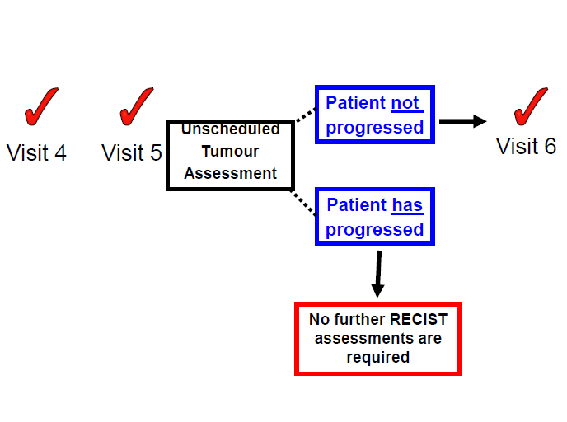
Unscheduled Tumour Assessments

Slide 52
Summary

Slide 53
Summary (1)
RECIST1.1 is used to standardize solid tumour response evaluation
At baseline the tumour burden is categorized in terms of Target and Non-Target Lesions
Measurement of Target Lesions made at all time points
Longest diameter for non-nodal lesions
Short axis for lymph nodes (nodal lesions)
All Target and Non-Target Lesions should be followed up at each tumour assessment visit by the same methods used at baseline

Slide 54
Summary (2)
Overall visit response is a combination of the Target Lesion response, Non-Target Lesion response and the presence or absence of any New Lesions
The categories of Overall Visit Response are:
Complete Response [CR]
Partial Response [PR]
Stable Disease (Non-CR/Non-PD) [SD]
Progressive Disease [PD]
To avoid bias, tumour assessments must be performed in accordance with the visit schedule
The Monitor should ensure that there is a process in place at each site for requesting RECIST 1.1 assessments and that the Source Data is appropriately documented.

Slide 55
Thank You

